Slide 1
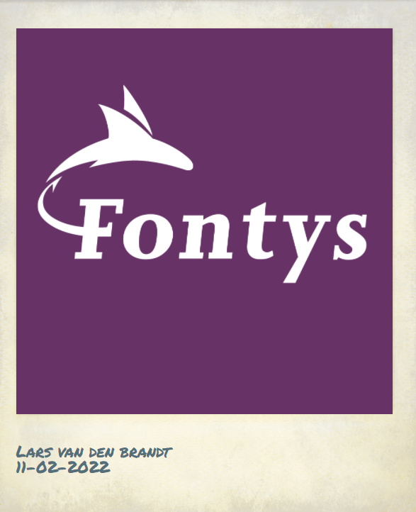
Project Idea – Lars van den Brandt
Project title: PolarGram
Description: A modern social media platform where you can share images. These images would be displayed with both a filter and a frame, to make it look like an old Polaroid photograph.
Why this idea: Almost everyone uses Instagram these days. But I noticed, in my own friend group, the old school Polaroids and disposable cameras are getting popular again. PolarGram is a platform that combines both the modern and older generation of photographs.
Non-functional
Requirements: Security, Reliability, Availability, Maintainability, Scalability
Technology: React // C# .NET Core 6.0 // Fontys GitLab
Example of modern image combined with Polaroid frame:

Slide 2
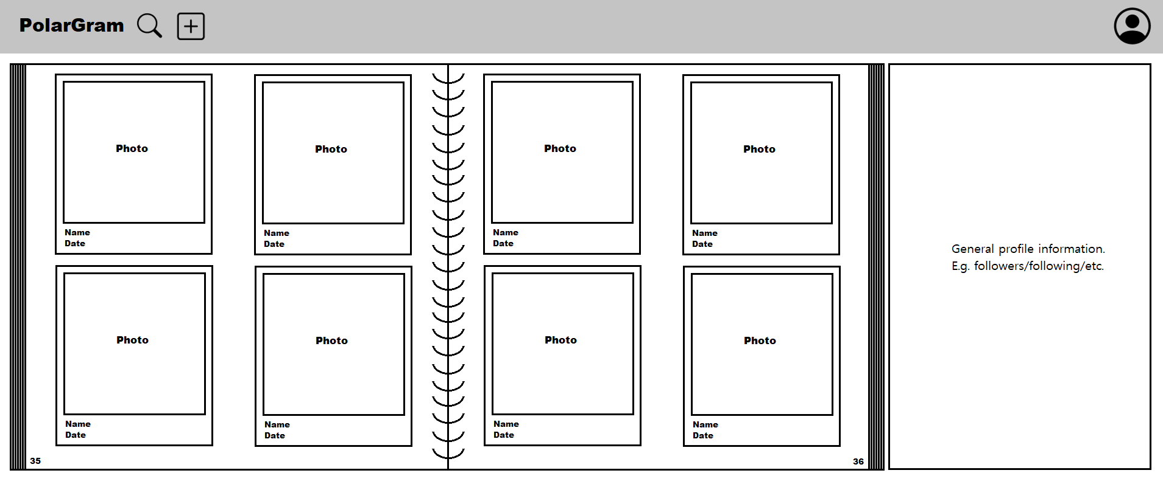
Example of what a PolarGram page could look like.
Images are illustrated as a photo book.

